Slide 1
Knowledge building and the quantity, content and quality of the interaction and participation of students in an online collaborative learning environment 知识建构与学生在线协作学习环境中交互和参与的数量、内容及质量
Ümmühan Avcı Yücel，Yasemin Koçak Usluel
Computers & Education 97 (2016)： 31-48
JCR分区：Q1，影响因子： 2.63

Slide 2
Outline
abstract
Introduction
Theoretical framework
Purpose of the study
Methods
Results and discussion
Conclusion

Slide 3
abstract
研究主题：The processes of knowledge building, the interaction and participation of students in an online collaborative learning environment and the relations among them are investigated.
研究过程：The investigation involved a procedure carried out over 14 weeks in an online collaborative learning environment. During the procedure, the knowledge building process was executed over Knowledge Forum and the planning process over Moodle LMS.
研究内容：The scaffolds, quantity, content and quality of interaction and participation, and relations between scaffolds and the quantity of interaction and participation were reviewed.
实验对象：The participants were 145 prospective teachers.
研究方法：In this research, a convergent parallel design method was employed.
数据收集与分析：Data were collected from multiple sources, including the log records and the content analysis of Knowledge Forum postings. Development was observed in terms of the use of opinion building and expressing forms and note creation and build-on of the students in the knowledge building processes within the online collaborative learning environment.

Slide 4
abstract
研究结论：There was a significant increase in the quality of interaction and participation from the beginning of the term to the end of term. It is suggested that the 14-week knowledge building process contributed to learning. It was found that there was a significant relation between the use of opinion building and expressing forms and the creation and build-on of notes by the students. Results show that the course offered in an online collaborative knowledge building environment contributed to opinion building and expression, the quantity, content and quality of interaction and participation, and thus the learning of students.

Slide 5
Introduction
The aim is thus for the created knowledge structures to contribute to the learning process. 知识建构的目标是为创建知识结构，以帮助学习过程。In that sense, there is a close relationship between learning and knowledge building.
Interaction and participation can be described as a process in which a mediator plays an important role between learners for the joint structuring of different opinions or common perspectives in the knowledge building process (Hong & Sullivan, 2009; Sing & Khine, 2006). 互动和参与可以被描述为一个过程，在这个过程中，学习者之间的中间人（协调者）起重要作用，中间人能够在知识建构过程中将不同意见或共同的观点联接起来。

Slide 6
Introduction
The ability to suggest different opinions in a collaborative and social way, to profoundly discuss these opinions and to develop the opinions by allowing for knowledge building can be considered difficult. This challenge entails the necessity of examining the relationship among interaction, participation and learning in online collaborative learning environments (Naranjo, Onrubia, & Segu_es, 2012). It is believed that knowledge building can be investigated in a multi-dimensional manner by considering interaction and participation together.
以合作和社会化的方式提出不同意见的能力，深入讨论这些意见，并通过构建知识而发展这些观点被认为是困难的。这个挑战使得验证互动、参与和在线协作学习环境中的学习之间的关系是非常必要的。人们认为，通过考虑互动和参与，可以从多种维度上探究知识建构。

Slide 7
Introduction
The literature on online collaborative learning environments focuses mainly on the quantity of interaction and participation, while there have been a limited number of analyses on the quality of interaction and participation.
The present study focuses on the content, quantity and quality of interaction and participation in knowledge building processes occurring within online collaborative learning environments.
有关在线协作学习环境的文献主要集中在互动和参与的数量上，而关于互动和参与质量的分析比较少。
从这个角度来看，本研究着重于在线协作学习环境中互动和参与知识构建过程的内容、数量和质量。

Slide 8
Theoretical framework
Students will respond not only within their own friend groups but to all group members and even other groups to which the students think they can contribute in discussion (Law et al., 2011)
Students need various features and opportunities that support the knowledge building process (Lee, Chan, & van Aalst, 2006).
It is observed that “scaffolds” draw the most attention to these features supporting knowledge building (Scardamalia, Bransford, Kozma, & Quellmalz, 2012).
学生不仅会在自己的朋友群体中作出反应，而且会对所有群体成员甚至其他群体成员做出反应，学生认为他们能在讨论中做出贡献。
学生需要支持知识建构过程的各种特征和机会。
“支架”最受关注，它支持知识建构。

Slide 9
Theoretical framework
Scaffolds
Scaffolds are one type of knowledge building support features that students can use to form and discuss their own opinions in the knowledge building process (Law et al., 2011). The use of scaffolds to reflect students' socio-cognitive (Scardamalia, 2002) and socio-metacognitive (Law, 2005) responsibilities is accepted as an important indicator of the knowledge building process in the literature. Scaffolds are considered important because they help students easily convey their opinions to themselves and group members.
Scaffolds are important in the online collaborative knowledge building process.
支架支持学生形成和讨论他们的观点。支架的使用是知识建构的一个重要指标。支架能够帮助学生轻松地表达自己的观点。在在线协作学习环境中支架是非常重要的。

Slide 10
Theoretical framework
Knowledge building process and online collaborative learning
Collaborative learning is a pedagogical process that encourages students to discuss information and problems from different perspectives, and to elaborate and refine their understanding to re- and co-construct (new) knowledge or to solve a problem (Veerman, 2000). This kind of learning environment provides students with the opportunity to participate in discussions and gives them the responsibility for their own learning.
合作学习鼓励学生从不同的角度讨论信息和问题，并阐述和完善自己的理解重新构建（新的）知识或解决一个问题。这种学习环境为学生提供了参与讨论的机会，让学生为他们的学习负责。

Slide 11
Theoretical framework
Knowledge building process and online collaborative learning
It is not guaranteed that all participators within the online collaborative learning environments will contribute to the knowledge building process or that a collaborative structure will be provided (Kreijns, Kirschner, & Jochems, 2003). Interaction and participation within these environments thus need to be examined in detail.
然而，不能保证在网络协作学习环境中，所有参与者都有助于知识建构，或者提供一个协同结构。因此，需要详细探究这些环境中的交互和参与。

Slide 12
Theoretical framework
Interaction and participation in online collaborative learning environments
The literature considers that online interaction and participation are key drivers for learning (Hrastinski, 2008).
The realization of participation is difficult without interaction, and similarly, it is expected that interaction occurs in an environment where there is participation (Wenger, 1998).
That is, every student participating in an online collaborative learning environment is actually thought of as providing an interaction. Interaction and participation that are closely relevant to each other are thus examined together in the present study.
没有交互而要实现参与是困难的，同样，在学习环境中有交互发生，就会有参与存在。就是说，每一个学生参与在线协作学习环境其实是想参与互动。互动和参与彼此密切相关，因此在本研究中将两者放在一起来研究。

Slide 13
Purpose of the study
The aim of the study is to examine the knowledge building processes of the students, the interaction and participation of the students and the relation between knowledge building processes and interaction and participation in the environment. The study thus contributes to the comprehension and development of the knowledge building process in a holistic way. To accomplish this goal, the following sub-problems are posed.
本研究旨在探讨学生的知识建构过程、学生的互动与参与以及知识建构过程与环境互动与参与的关系。因此，这项研究有助于全面理解和发展知识建构过程。为实现这一目标，提出了以下子问题。

Slide 14
Purpose of the study
1. What are the knowledge building processes of students according to scaffolds within an online collaborative learning environment in the context of a course?
1.1 What are the knowledge building processes of the students according to their opinion building forms?
1.2 What are the knowledge building processes of the students according to their opinion expression forms?
2. What are the interaction and participation of the students within an online collaborative learning environment in the context of a course?
2.1 What is the quantity of interaction and participation of the students?
2.2 What is the content of interaction and participation of the students?
2.3 What is the quality of interaction and participation of the students?
3. What is the relation between the quantity of interaction and participation of the students and scaffolds as knowledge building process within an online collaborative learning environment in the context of a course?

Slide 15
Methods
The methodology of the present study has a convergent parallel design.
First, both quantitative and qualitative data are collected in this study.
Second, the two data sets are analyzed separately and independently.
Third，Results of the two data sets are combined through correlation.
In the final stage, to what extent and in what ways this relation occurs is interpreted in accordance with the aim of the research.

Slide 16
Methods
1. Participants
The study group consists of 145 prospective teachers taking the course “Instructional Technologies and Material Development Spring 2011-2012” at a private university in Ankara, Turkey.
Students in these five departments were distributed into six branches. In creating the branches, an effort was made to distribute the students evenly and a total of 19 groups each comprising six to nine students were formed.
该研究小组由145个准教师参与，在土耳其安卡拉的一所私立大学，他们参加了2011-2012上期的《教育技术与资源开发》这门课。被试分布在6个班，19个组，每个组6到9个人。

Slide 17
Methods
2. Procedure
An online collaborative learning was primarily designed.
The program Knowledge Forum was selected as the procedure environment.
The groups were formed.
Scaffolds were introduced in the procedure environment.
A syllabus that contained the discussion topics and details for each week was prepared for the instructor and students.
The knowledge building process in the context of a course was then carried out in this environment for 14 weeks.

Slide 18
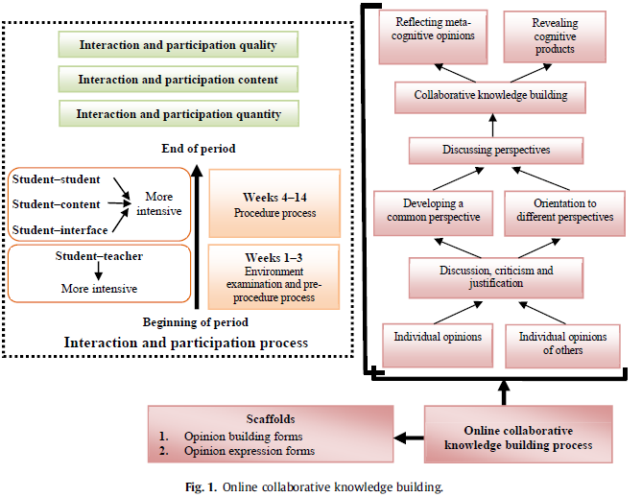
Methods
2. Procedure

Slide 19
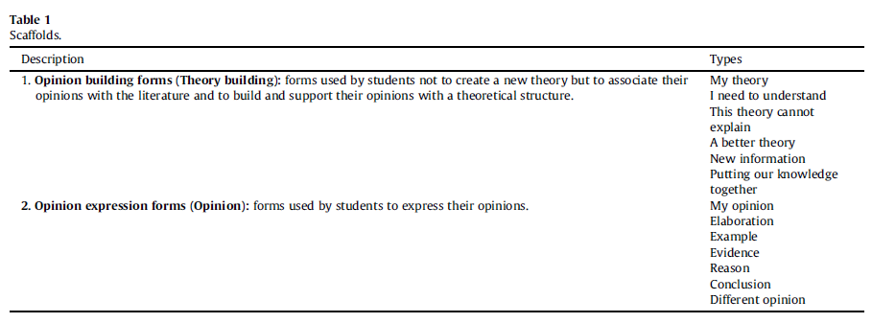
Methods
3. Data collection tools
The following data collection tools were used within the scope of this study.
▪ Online collaborative learning environment (Knowledge Forum) log records
日志记录

Slide 20
Methods
3. Data collection tools
The following data collection tools were used within the scope of this study.
▪ Coding scheme created by Hou and Wu (2011) for the content analysis of knowledge building and social interaction in synchronous discussion-based learning activities
同步讨论的学习活动中，知识建构和社会交互的内容分析编码体系
A total of 3112 codes were obtained as a result of discussion among 40 students. The entire record was then recoded by another coder with the same expertise to ensure inter-rater consistency. The kappa coefficient was 0.67, which reached the 0.001 level of significance.
在40名学生的讨论中，共获得了3112个代码。整个记录被另一个具有相同专业知识的专家进行编码，以确保评分者间的一致性。Kappa系数为0.67，达到了0.001的显著水平。

Slide 21
Methods
3. Data collection tools
The following data collection tools were used within the scope of this study.
▪ A rubric for the assessment of the quality of interaction and participation within the knowledge building process (Avci Yucel & Usluel, 2013)。交互与参与质量的评价量规。
The present study used a rubric developed by Avci Yucel and Usluel (2013) to assess the interaction and participation quality in the online collaborative learning environment. This rubric has four indicators: the contribution of discussion messages to the task, the relevance of discussion messages to the topic, the continuity of discussion messages, and the direction of relations between discussion messages.
这个量规有四个指标：贡献与任务相关的讨论信息，讨论信息与主题的相关性，讨论信息的连续性，讨论信息之间关系的指向。

Slide 22
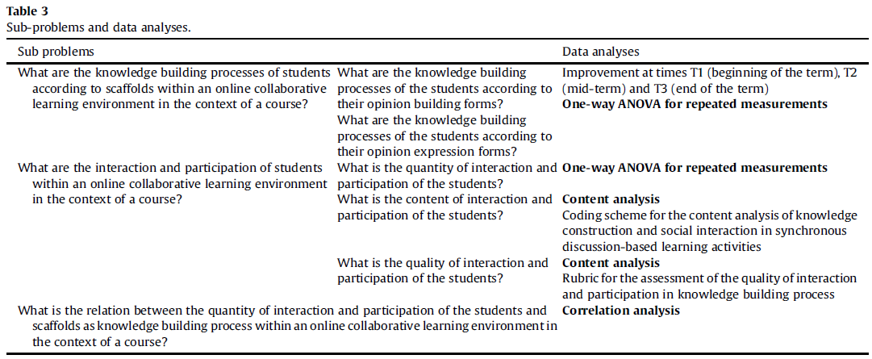
Methods
4. Data analysis

Slide 23
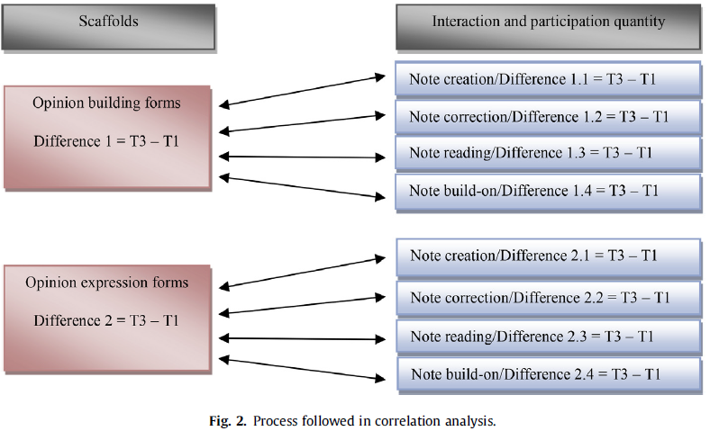
Methods
4. Data analysis

Slide 24
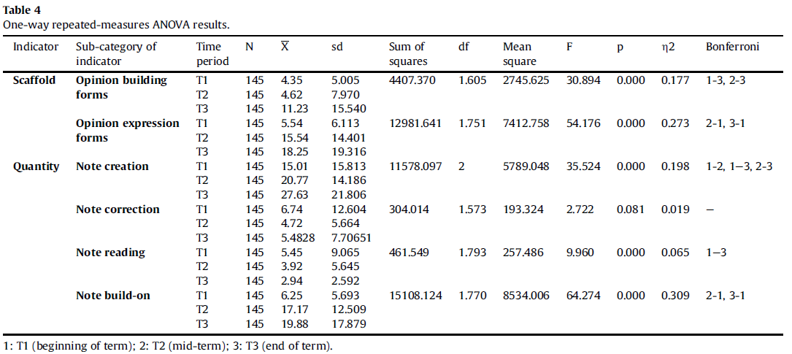
Results and discussion
1. Findings on the knowledge building process and quantities of interaction and participation of students

Slide 25
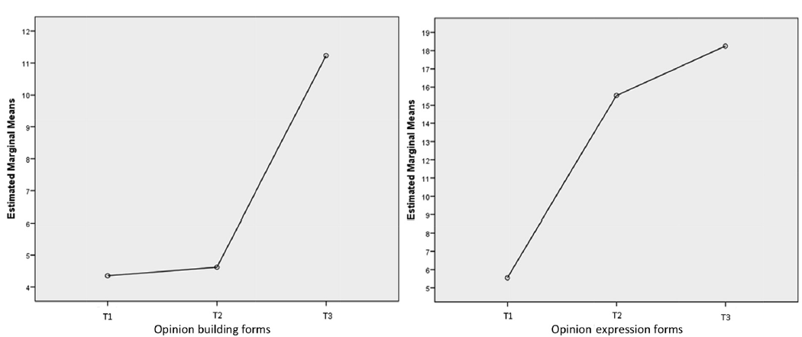
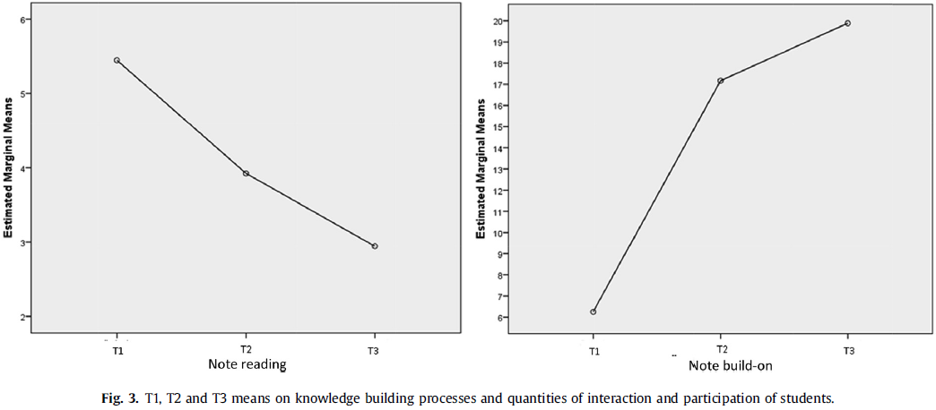
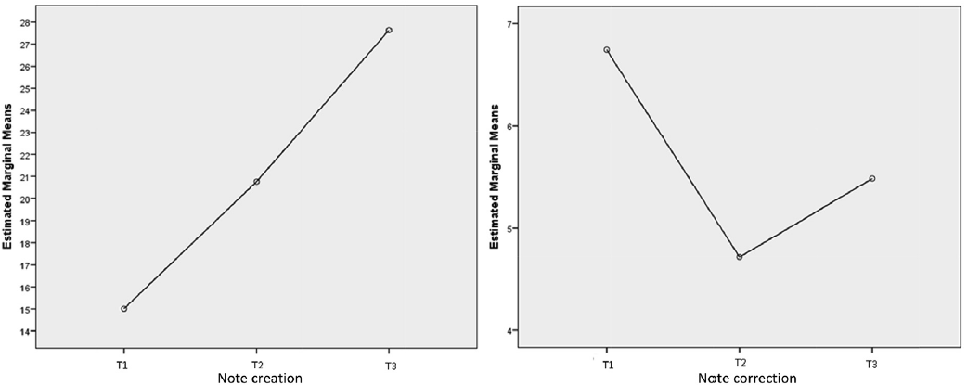
Results and discussion
1. Findings on the knowledge building process and quantities of interaction and participation of students

Slide 26
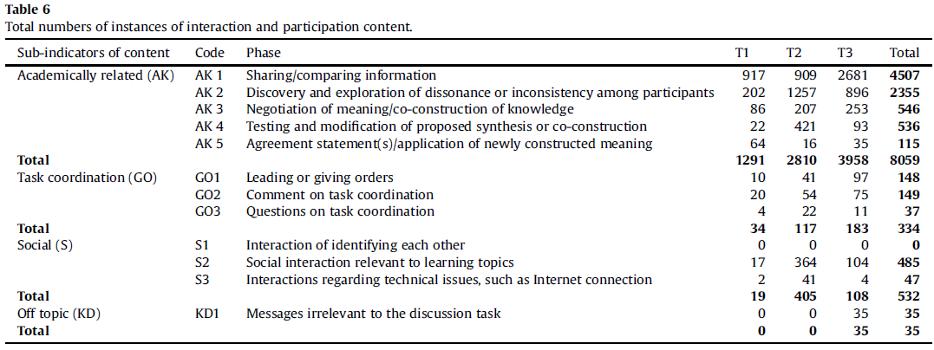
Results and discussion
2. Findings on the content and quality of the interaction and participation of students
Findings on the content of interaction and participation of students

Slide 27
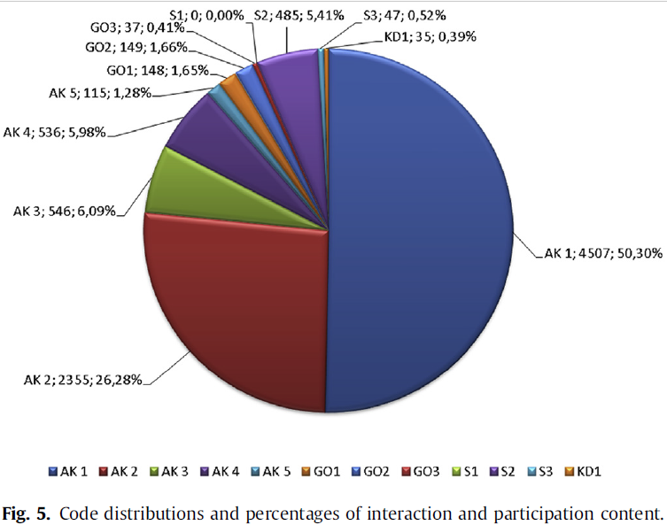
Results and discussion
2. Findings on the content and quality of the interaction and participation of students
Findings on the content of interaction and participation of students

Slide 28
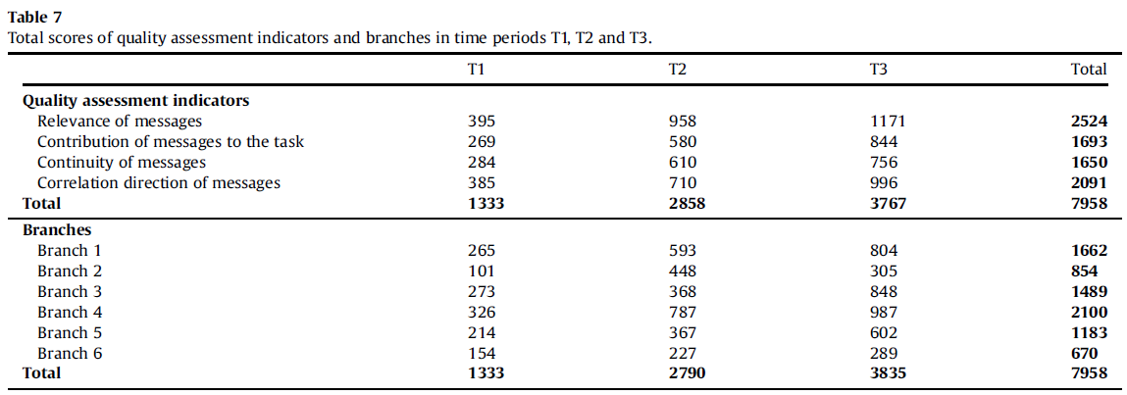
Results and discussion
2. Findings on the content and quality of the interaction and participation of students
Findings on the quality of the interaction and participation of students

Slide 29
Results and discussion
3. Findings on the relation between the interaction and participation of students and the knowledge building process

Slide 30
Conclusion
An increasing improvement in the quality of student participation and interaction from the beginning to the end of the term was observed in scaffolds in the knowledge building process within the scope of this study.
Scaffolds are representations of a teacher in the knowledge building process. Scaffolds play the role of a teacher by supporting and leading students in expressing and building their opinions in a knowledge building process without a teacher;

Slide 31
Conclusion and recommendations
The relation between the use of scaffolds in knowledge building processes and the quantities of note creation and note build-on shows that the interaction and participation quantity is an important component of the online collaborative knowledge building process. It can thus be stated that these indicators support and trigger each other. Improvements of students related to knowledge building processes will be seen in the students' interaction and participation.
The present study revealed that a course conducted within an online collaborative knowledge building environment can contribute to the opinion building and expression of students; improve the quantity, content and quality of the interaction and participation of students; and thus the learning of students.

